Slide 1
Identify Material Degradation by Deep Learning Approach
Yunli Zhang
Rui Shi

Slide 2
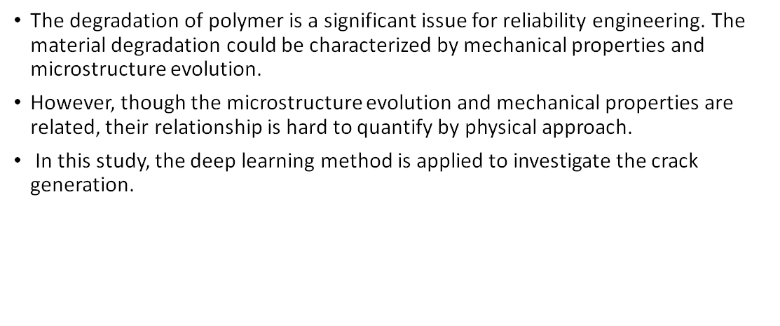
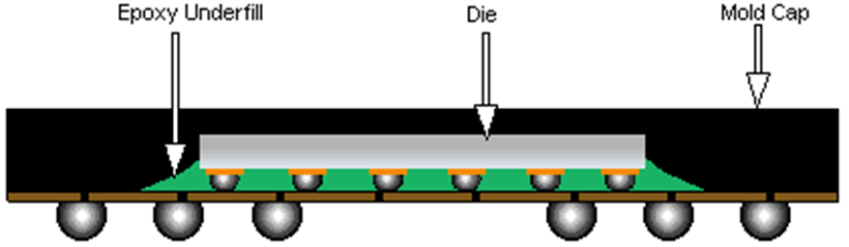
Research Motivation

Slide 3
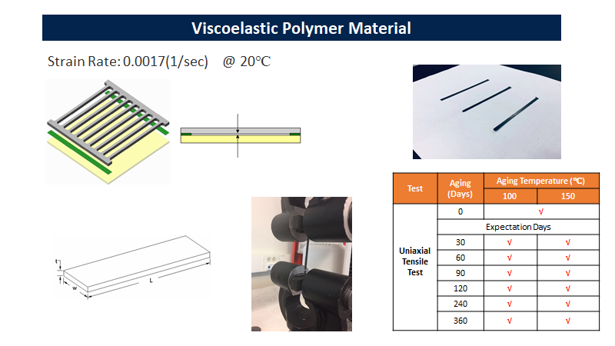

Slide 4
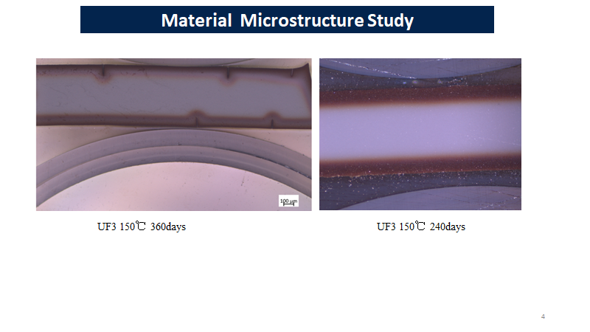

Slide 5
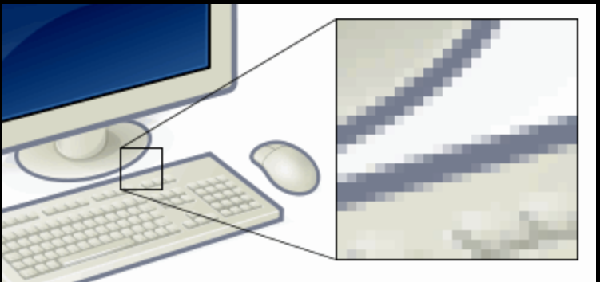
Graphics: Digital Image Processing
A digital image is made of “pixels” arranged in a grid of rows and columns.

Slide 6
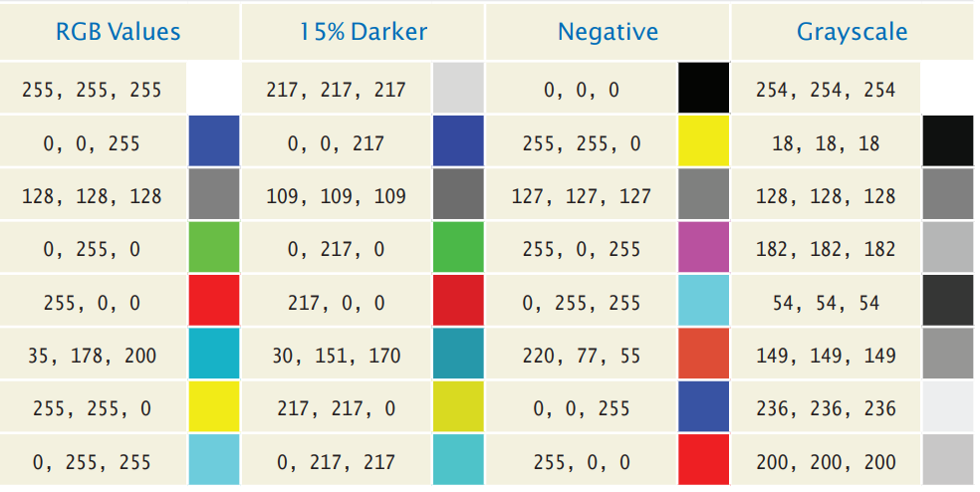
Graphics: Digital Image Processing
There are different ways to specify a color, but the most common is to use the discrete RGB color model.
The amount of each color is specified by a number.

Slide 7
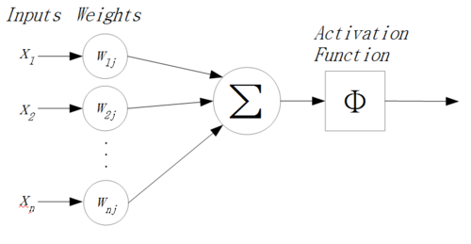

Brief Intro on Neural Network
1, M-P Neuron Model

Slide 8
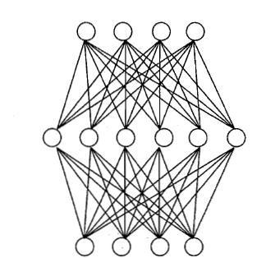
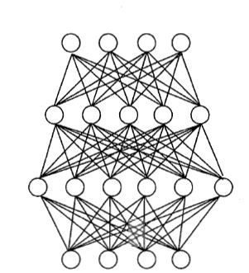
Brief Intro on Neural Network
2, Multi-layer feedforward neural network

Slide 9
Brief Intro on Neural Network
3, Error BackPropagation
(1), First randomly choose thresholds and weights.
(2), Compute output error. (MSE, classification error).
(3), Update thresholds and weights correspondingly.
Go back to (2).
(4), Stops if the output error converges.

Slide 10
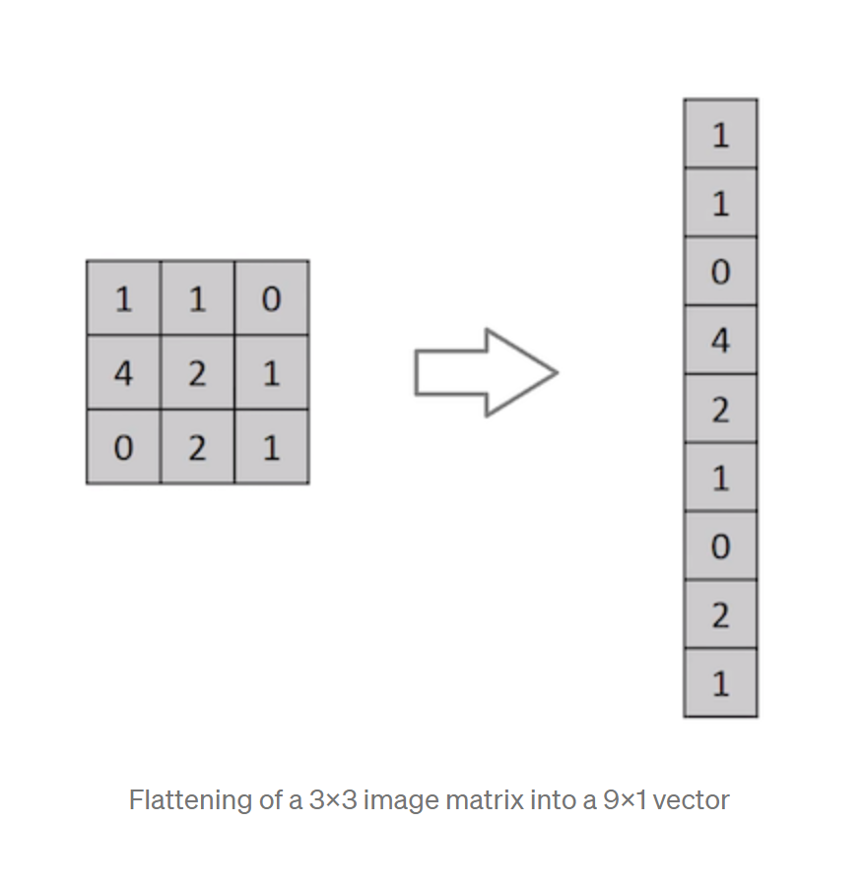
Neural Network on Image Processing
Neural Network can’t take images as the input, we need to flat image matrix.
Drawback:
pixel spatial dependencies?

Slide 11
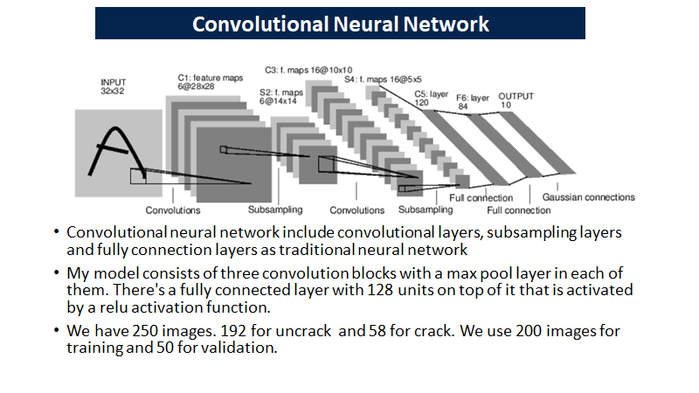

Slide 12
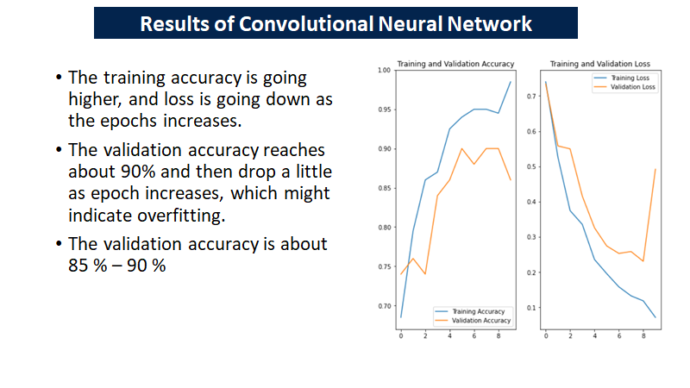

Slide 13
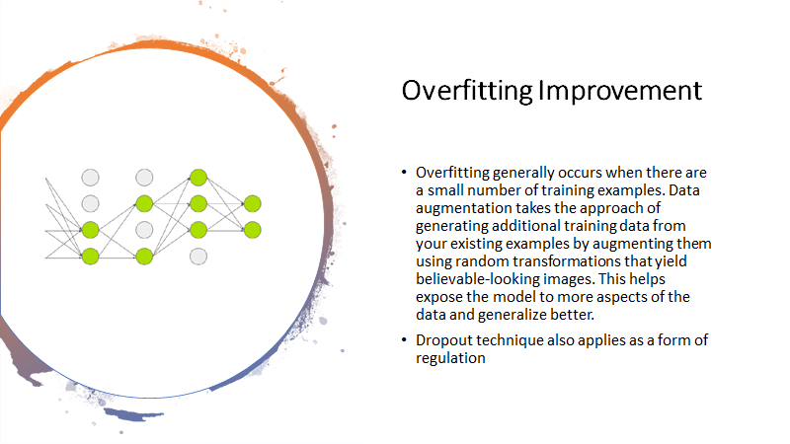

Slide 14
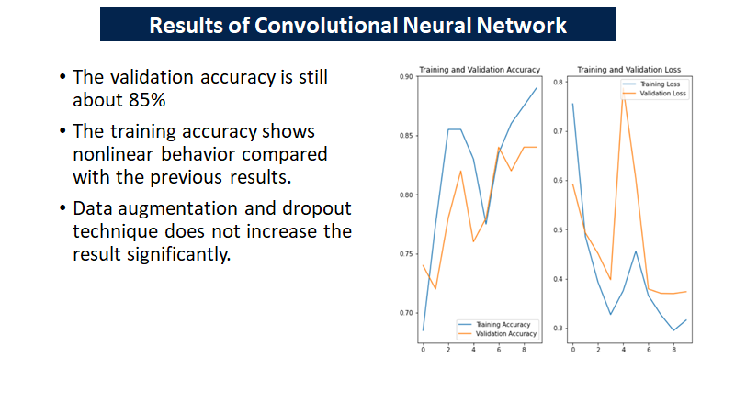

Slide 15
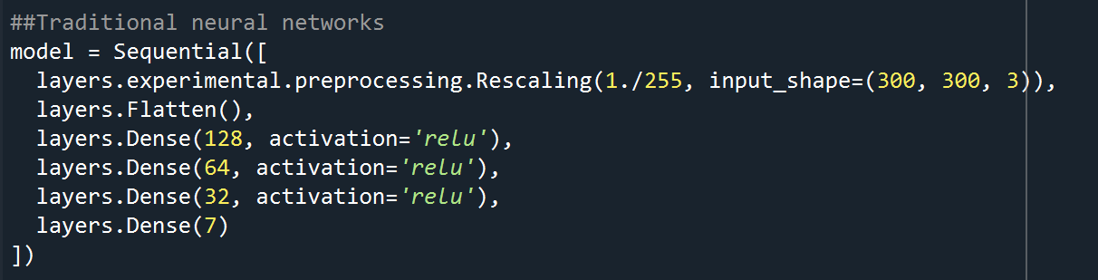
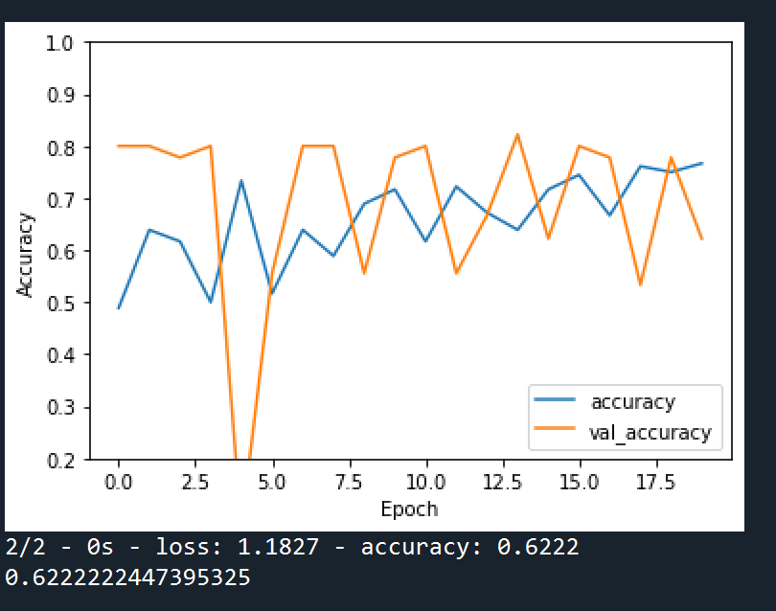
Model Structure and Result:

Slide 16
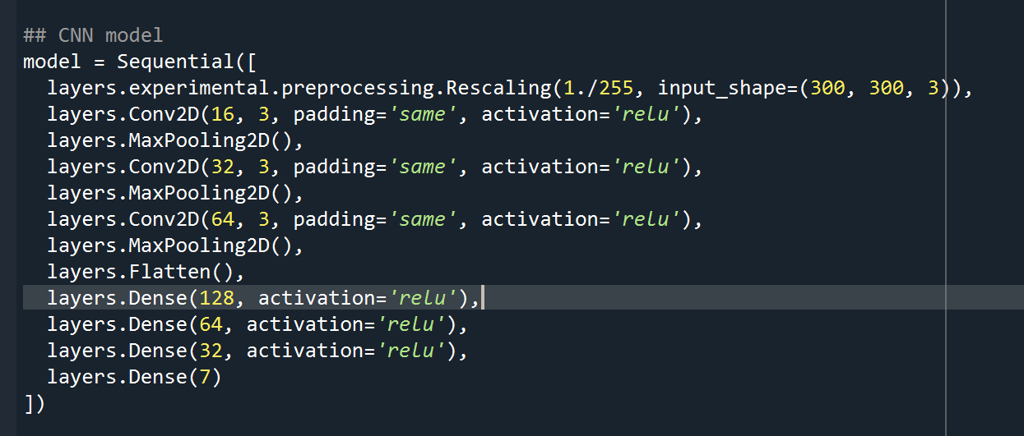
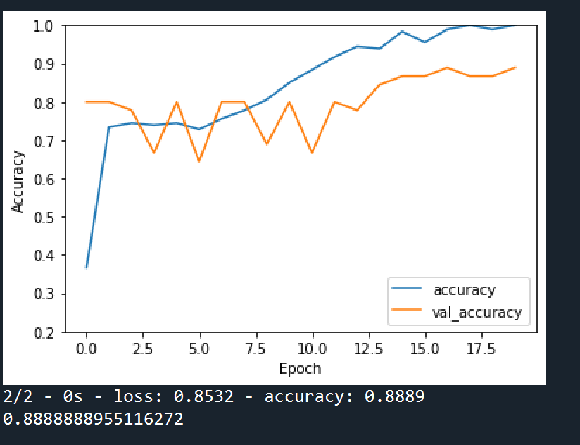
Model Structure and Result:

Slide 17
Conclusion and Challenges
•In this study, 250 images have been input as small samples classifications.
•One of the biggest challenges is to install the TensorFlow and setup the environments ^_^
•CNN could be successfully implemented as classifier for small sample material classification problems.
•Sample quality is significant, maybe essential for classification problem. The better features, the higher accuracy. Advanced algorithm is more like powerful assistant but not magician.
•Macrostructure mechanical properties and microstructure behavior could be related by machine learning tool.

